Slide 1
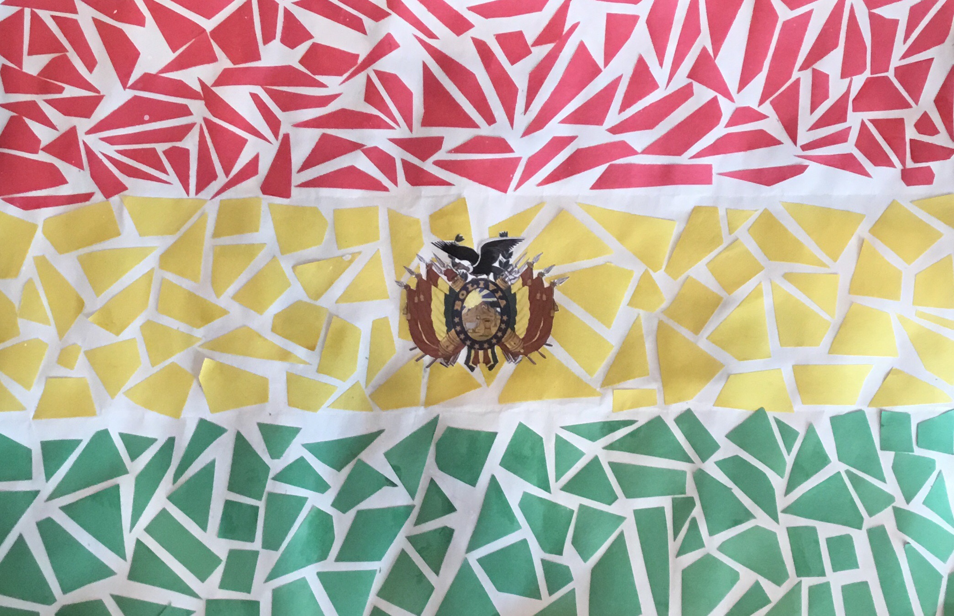
Welcome to Bolivia!
(Click the photo to see the country or continue to the next slide for more info)

Slide 2
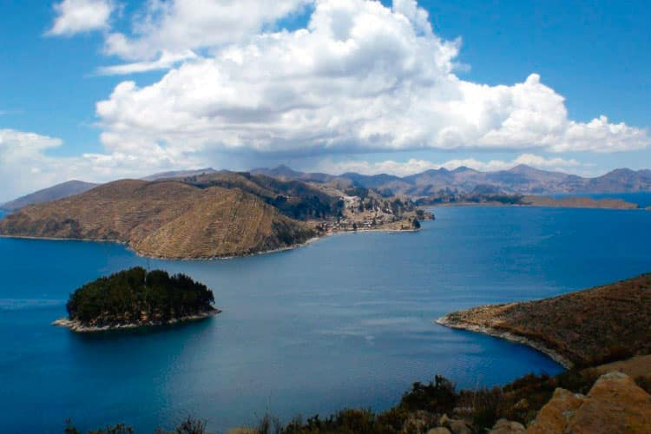
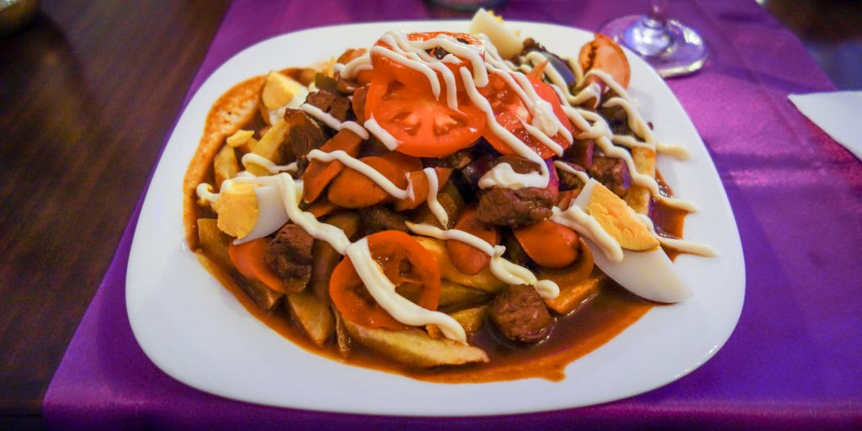
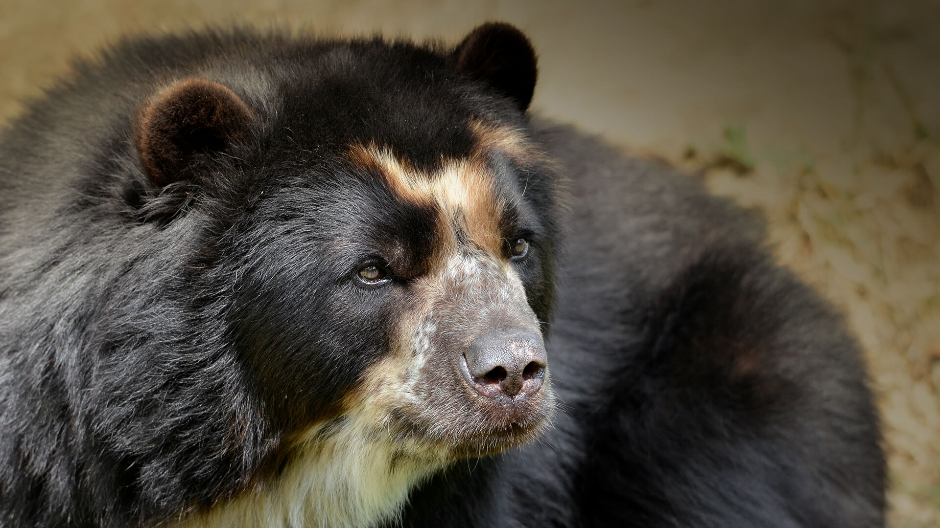
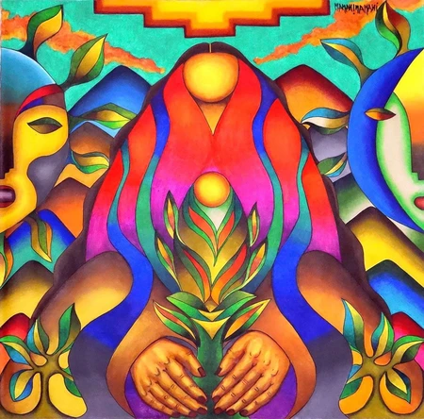
Click on the photos below for original art and facts.
Landmarks
Food
Flora and Fauna
Art

Slide 3
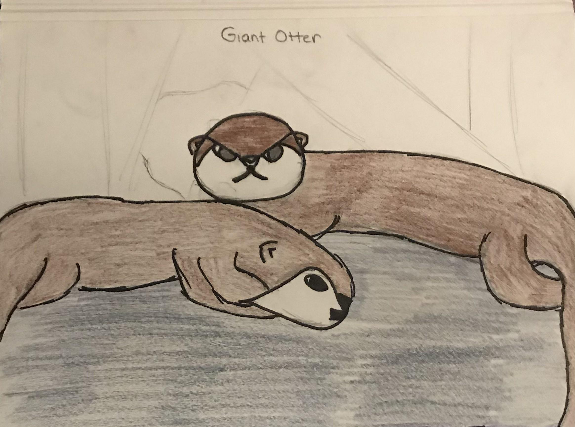
Bolivian Flora and Fauna (Plants and Animals)
Back to contents
Giant River Otters live in tropical areas. Mostly in the Amazon Rainforest and River. They can reach up to 6 feet long and will take on anything that threatens them. This is including Jaguars and Caimans.
Quinoa is a Fair Trade Product grow in Bolivia for food. In the past the quinoa was grown on the mountains but is now mostly grown on flat plains.

Slide 4
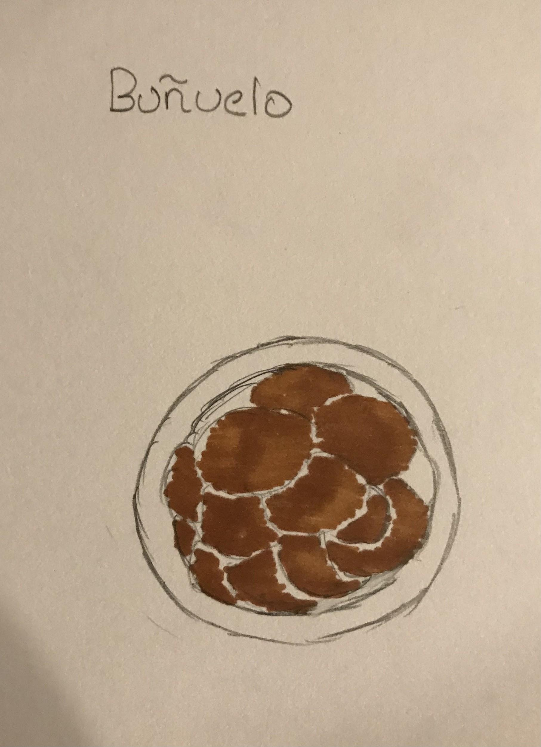
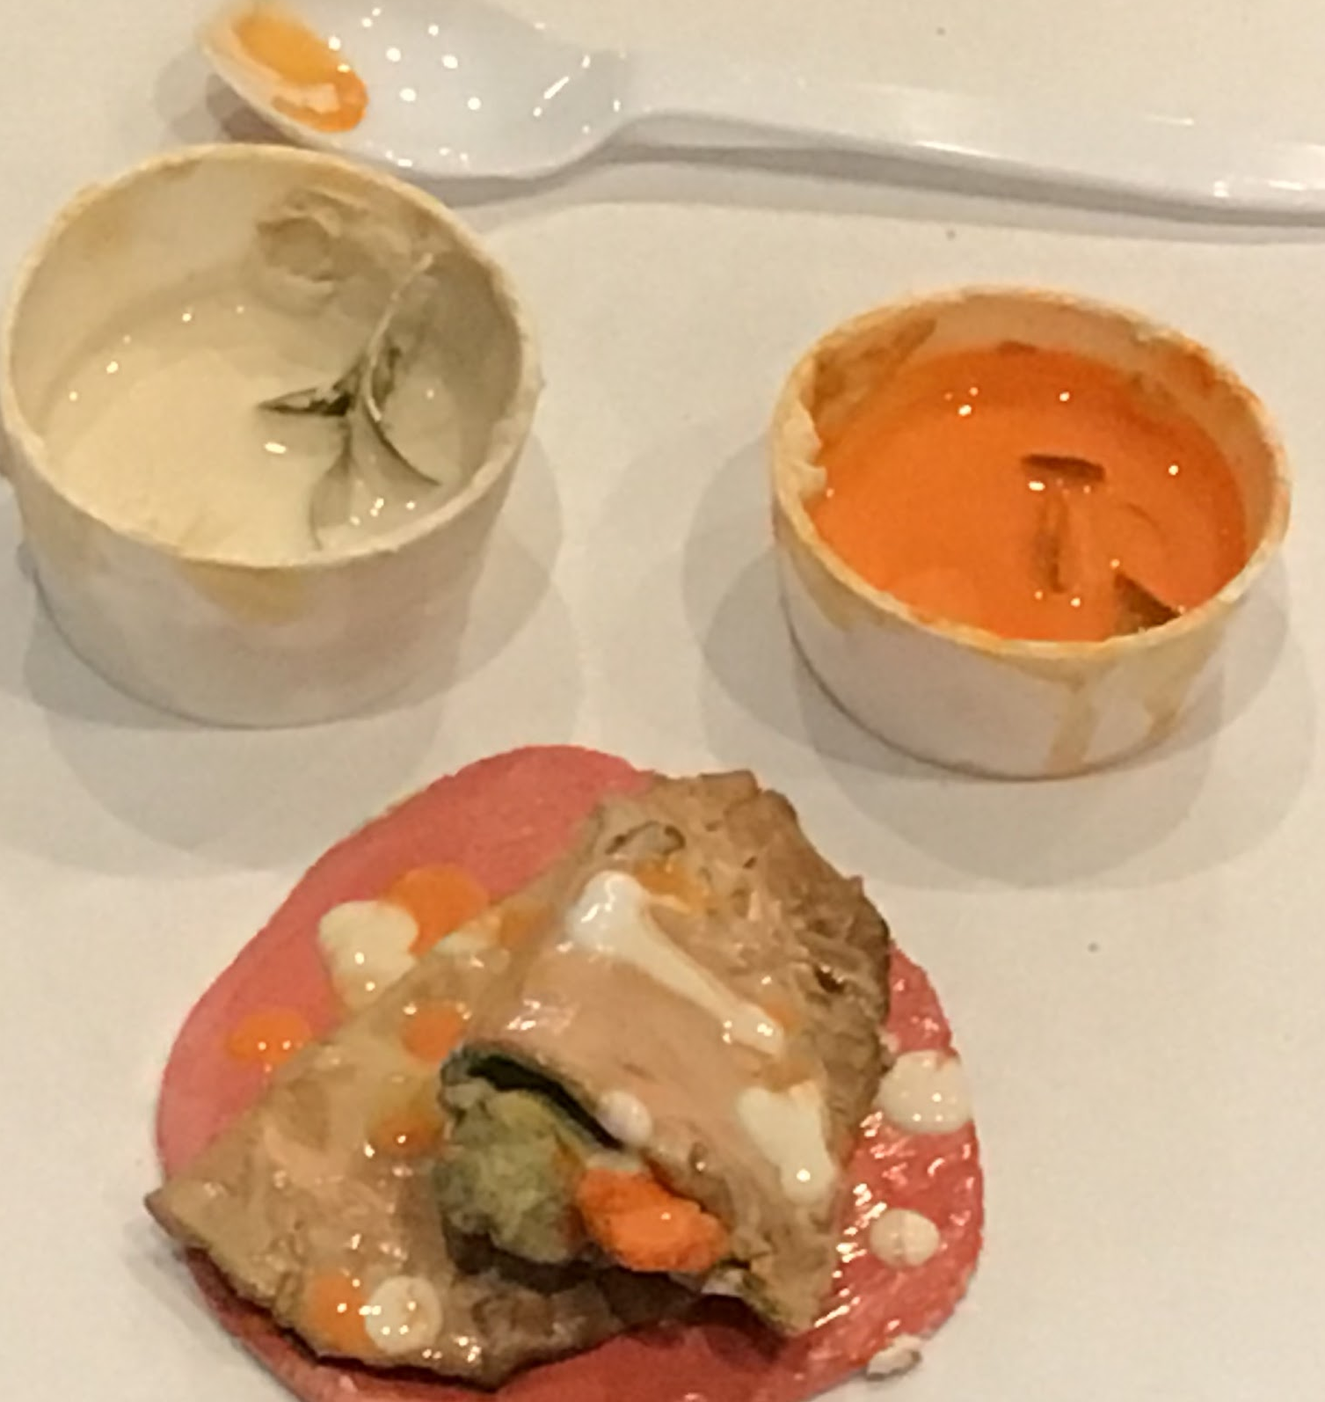
Bolivian Food
Back to contents
Buñuelo is a popular dessert dish in Bolivia. Like a donut, it is mostly fried dough and may be served with powdered sugar as shown in the picture above.
Empanada is a baked or fried pastry stuffed with meat, cheese, vegetables, fruits, and other ingredients.

Slide 5
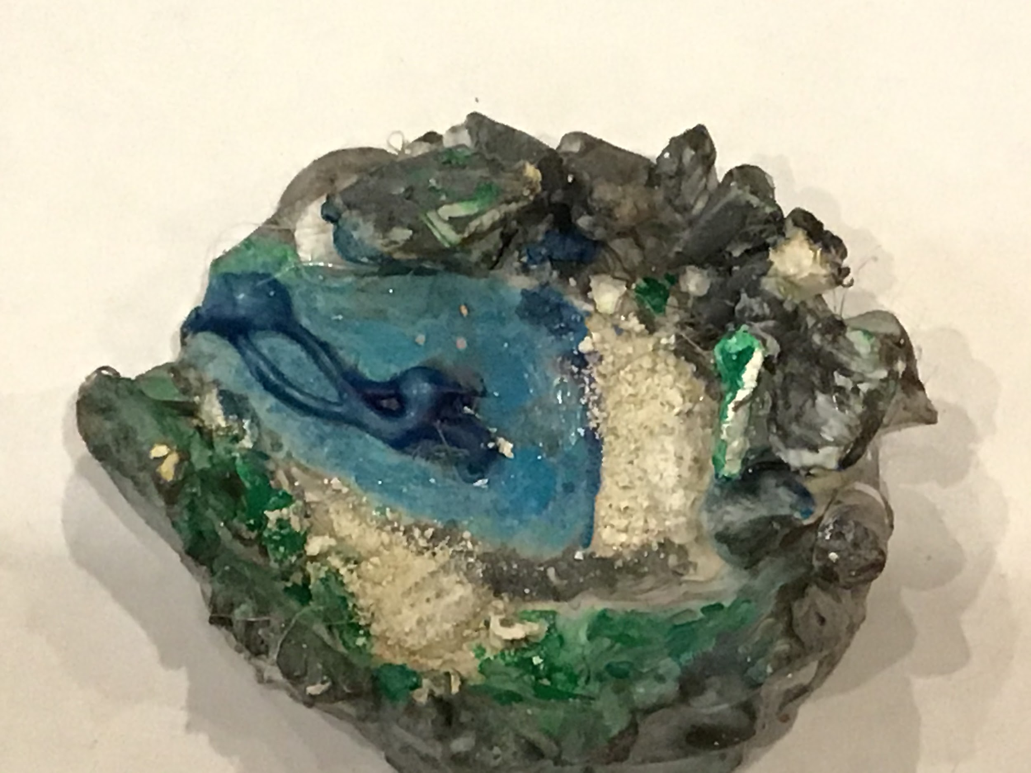
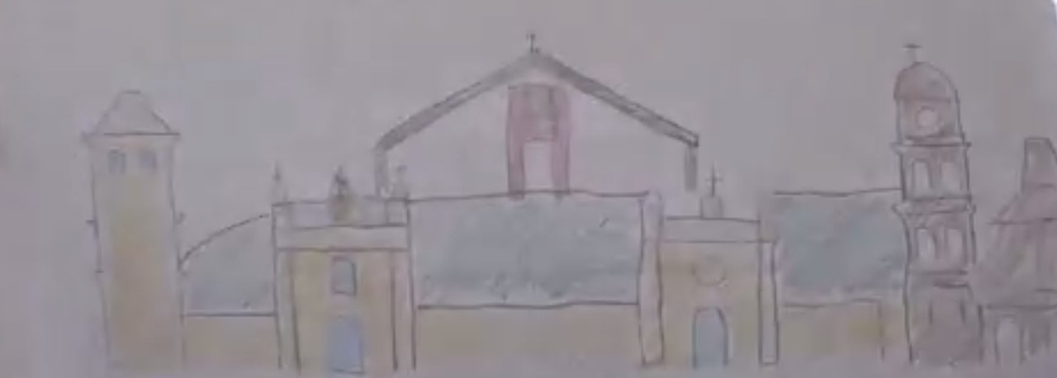
Bolivian Landmarks
Back to contents
Lake Titicaca is a large, freshwater lake which sits on the border of Bolivia and Peru. It is known for its amazing sunsets and crystal clear blue water.
La Cruz De La Paz

Slide 6
Bolivian Traditional Art
Back to contents

Slide 7
Fun Facts
The colors of the Bolivia flag mean, red - army, yellow - resources, and green - the fertility of the land.
In Bolivia there are more than 2,000 know species!

